Slide 1
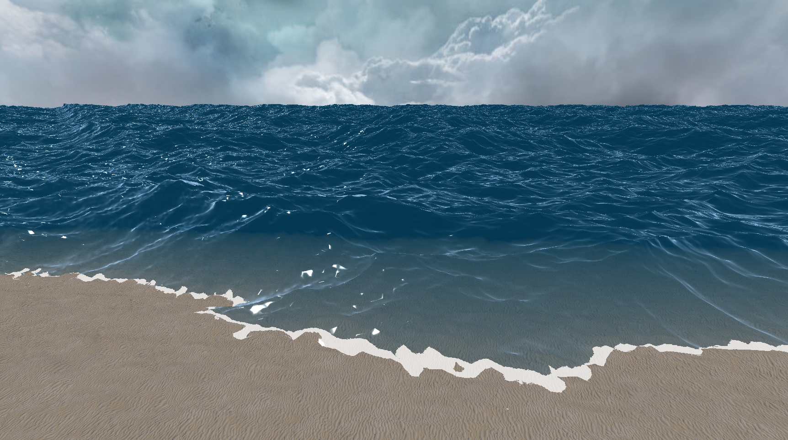
Large Scale Realistic Ocean Rendering and Simulation
Spencer McKean
Figure 1: Large Scale Ocean Rendering

Slide 2
Agenda
Background
Demo
The Surface Simulation
The Appearance of Water
Additional Effects
Project Breakdown
Background
Demo
The Surface Simulation
The Appearance of Water
Additional Effects
Project Breakdown

Slide 3
Agenda
Background
Demo
The Surface Simulation
The Appearance of Water
Additional Effects
Project Breakdown

Slide 4
Agenda
Background
Demo
The Surface Simulation
The Appearance of Water
Additional Effects
Project Breakdown

Slide 5
Introduction
Background
Demo
The Surface Simulation
The Appearance of Water
Additional Effects
Project Breakdown
Inspired by Sea of Thieves
Large scale ocean surface simulation based on the Fourier Transform
Mimic the appearance of water
Interactive surface

Slide 6
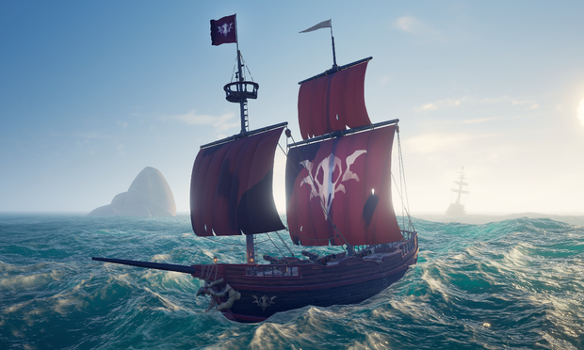
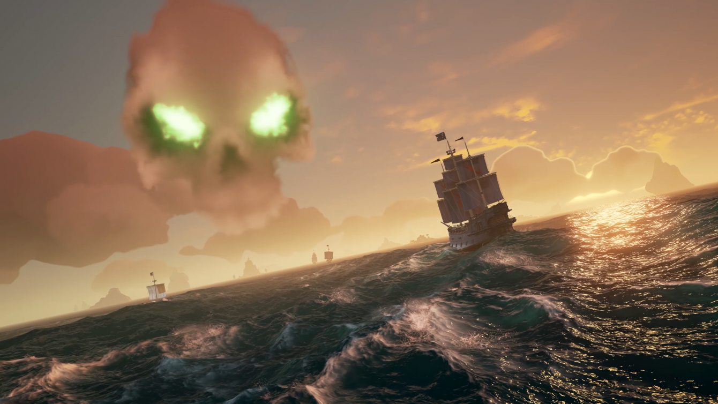
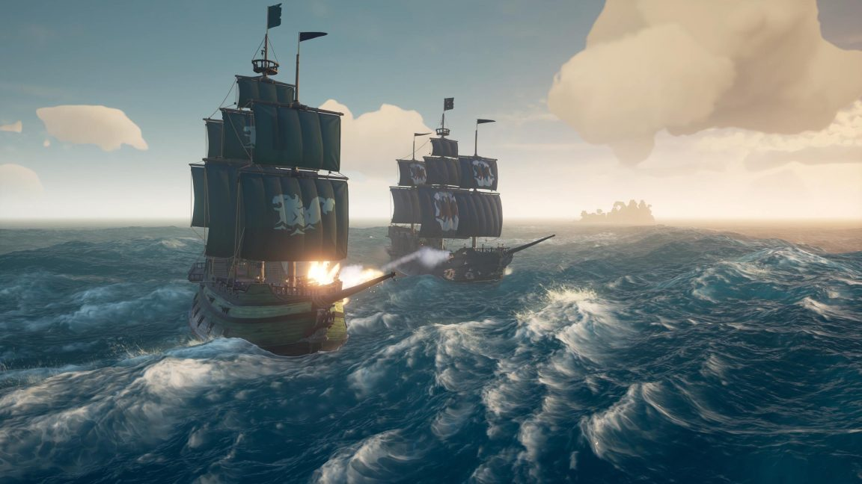
Background
Demo
The Surface Simulation
The Appearance of Water
Additional Effects
Project Breakdown
Figure 2: Sea of Thieves screenshot [1]
Figure 3: Sea of Thieves screenshot [2]
Figure 4: Sea of Thieves screenshot [3]

Slide 7
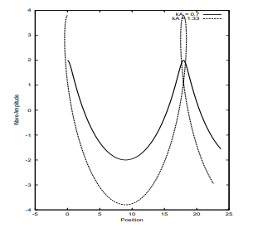
Why Do We Care?
Background
Demo
The Surface Simulation
The Appearance of Water
Additional Effects
Project Breakdown
Industry standard is Gerstner Waves
Simply adding different sine wave heights together
Can quickly result in overlapping wave peaks
Hard to make complex surfaces
Easy to implement
Discrete Fourier Transform does not cut it
Time complexity becomes an issue as the mesh density increases
Figure 5: Potential issues with Gerstner Waves [4]

Slide 8
Agenda
Background
Demo
The Surface Simulation
The Appearance of Water
Additional Effects
Project Breakdown

Slide 9
Demo
Background
Demo
The Surface Simulation
The Appearance of Water
Additional Effects
Project Breakdown

Slide 10
Agenda
Background
Demo
The Surface Simulation
The Appearance of Water
Additional Effects
Project Breakdown

Slide 11





















The Wave Vector
Background
Demo
The Surface Simulation
The Appearance of Water
Additional Effects
Project Breakdown
$$dx$$
$$L=(L_{x},L_{y})$$
$$−\frac{N}{2}≤n<\frac{N}{2}$$
$$−\frac{M}{2}≤m<\frac{M}{2}$$
$$dx= \frac{L_{x}}{N}$$
$$dy= \frac{L_{y}}{M}$$
$p=(ndx,mdy$)
$\overset{⃑}{k}=(\frac{2πn}{L_{x}},\frac{2πm}{L_{y}}$)
$$M=8$$
$$3$$
$$dy$$
$$L=\left(4,4\right)$$
$$N=8$$
$$M=8$$
$$dx=0.5$$
$$dy=0.5$$
$$p=(0.5, 0.5)$$
$$\overset{⃑}{k}≈(.785, .785)$$
$$2$$
$$1$$
$$L_{y}$$
$$0$$
$−$1
$−$2
$−$3
$$−4$$
$$N=8$$
$$−4$$
$−$3
$−$2
$−$1
$$0$$
$$1$$
$$2$$
$$3$$
$$L_{x}$$

Slide 12

The Fourier Equations
Background
Demo
The Surface Simulation
The Appearance of Water
Additional Effects
Project Breakdown
$$h\left(p,t\right)=\sum_{\overset{⃑}{k}}{\tilde{h}(\overset{⃑}{k},t)}e^{i\overset{⃑}{k}∙p}$$
$$\tilde{h}\left(\overset{⃑}{k},t\right)= {\tilde{h}}_{0}\left(\overset{⃑}{k}\right)e^{iω\left(k\right)t}+{\tilde{h}}_{0}^{∗}(−\overset{⃑}{k})e^{−iω\left(k\right)t}$$
$${\tilde{h}}_{0}(\overset{⃑}{k})=\frac{1}{\sqrt{2}}\left(ξ_{r}+{iξ}_{i}\right)\sqrt{P_{h}(\overset{⃑}{k})}$$
$$P_{h}(\overset{⃑}{k}) = A\frac{e^{−1/{(kL)}^{2}}}{k^{4}}{\left|\hat{k}∙\hat{ω}\right|}^{2}$$

Slide 13
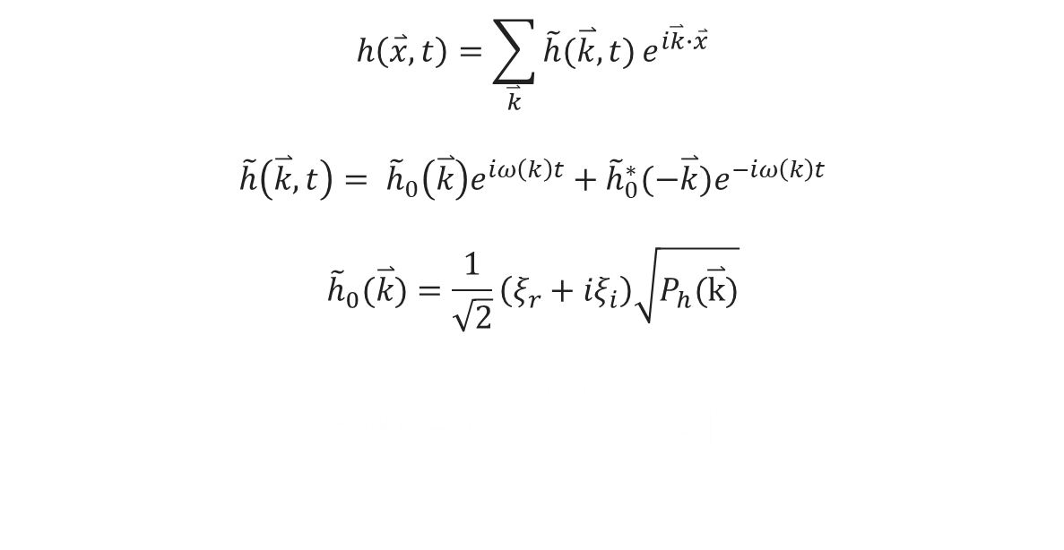
The Fourier Equations
Background
Demo
The Surface Simulation
The Appearance of Water
Additional Effects
Project Breakdown
$$h\left(\overset{⃑}{x},t\right)=\sum_{\overset{⃑}{k}}{\tilde{h}(\overset{⃑}{k},t)}e^{i\overset{⃑}{k}∙\overset{⃑}{x}}$$
$$\tilde{h}\left(\overset{⃑}{k},t\right)= {\tilde{h}}_{0}\left(\overset{⃑}{k}\right)e^{iω\left(k\right)t}+{\tilde{h}}_{0}^{∗}(−\overset{⃑}{k})e^{−iω\left(k\right)t}$$
$${\tilde{h}}_{0}(\overset{⃑}{k})=\frac{1}{\sqrt{2}}\left(ξ_{r}+{iξ}_{i}\right)\sqrt{P_{h}(\overset{⃑}{k})}$$
$$P_{h}(\overset{⃑}{k}) = A\frac{e^{−1/{(kL)}^{2}}}{k^{4}}{\left|\hat{k}∙\hat{ω}\right|}^{2}$$

Slide 14


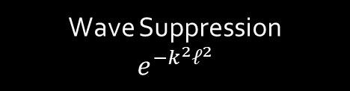
The Phillips Spectrum
Background
Demo
The Surface Simulation
The Appearance of Water
Additional Effects
Project Breakdown
$$P_{h}(\overset{⃑}{k}) =A\frac{e^{−1/{(kL)}^{2}}}{k^{4}}{\left|\hat{k}∙\hat{ω}\right|}^{2}$$
$\overset{⃑}{k}=$Wave Vector
$k$ = $\left\|\overset{⃑}{k}\right\|$
$L$= $\frac{V^{2}}{g}$
$V$= Wind Speed
$g$= Gravitational Constant
$\hat{ω}$ = Wind Direction
$A$ = Global Wave Amplitude
Wave Suppression
$$e^{−k^{2}ℓ^{2}}$$

Slide 15
The Phillips Spectrum
Background
Demo
The Surface Simulation
The Appearance of Water
Additional Effects
Project Breakdown
Graph 1: Phillips Spectrum values plotted over m an n

Slide 16
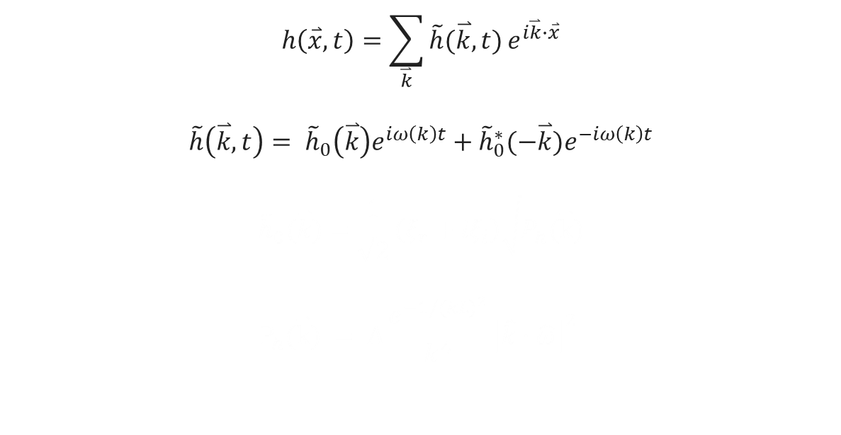
The Fourier Equations
Background
Demo
The Surface Simulation
The Appearance of Water
Additional Effects
Project Breakdown
$$h\left(\overset{⃑}{x},t\right)=\sum_{\overset{⃑}{k}}{\tilde{h}(\overset{⃑}{k},t)}e^{i\overset{⃑}{k}∙\overset{⃑}{x}}$$
$$\tilde{h}\left(\overset{⃑}{k},t\right)= {\tilde{h}}_{0}\left(\overset{⃑}{k}\right)e^{iω\left(k\right)t}+{\tilde{h}}_{0}^{∗}(−\overset{⃑}{k})e^{−iω\left(k\right)t}$$
$${\tilde{h}}_{0}(\overset{⃑}{k})=\frac{1}{\sqrt{2}}\left(ξ_{r}+{iξ}_{i}\right)\sqrt{P_{h}(\overset{⃑}{k})}$$
$$P_{h}(\overset{⃑}{k}) = A\frac{e^{−1/{(kL)}^{2}}}{k^{4}}{\left|\hat{k}∙\hat{ω}\right|}^{2}$$

Slide 17


Fourier Amplitudes
Background
Demo
The Surface Simulation
The Appearance of Water
Additional Effects
Project Breakdown
$${\tilde{h}}_{0}(\overset{⃑}{k})=\frac{1}{\sqrt{2}}\left(ξ_{r}+{iξ}_{i}\right)\sqrt{P_{h}(\overset{⃑}{k})}$$
$P_{h}\left(\overset{⃑}{k}\right)$ = Phillips Spectrum
$ξ_{r}+{iξ}_{i}$ = Gaussian Distributed Random Number
Notes:
Random pull can be different to create different looks
real waves tend to follow a guassian distribution

Slide 18
Fourier Amplitudes
Background
Demo
The Surface Simulation
The Appearance of Water
Additional Effects
Project Breakdown
Graph 2: Randomness applied to the Phillips Spectrum plotted over m an n
Notes:
Random pull can be different to create different looks
real waves tend to follow a guassian distribution

Slide 19
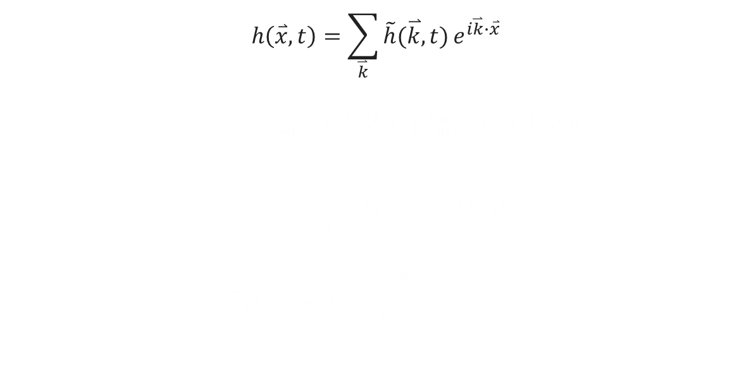
The Fourier Equations
Background
Demo
The Surface Simulation
The Appearance of Water
Additional Effects
Project Breakdown
$$h\left(\overset{⃑}{x},t\right)=\sum_{\overset{⃑}{k}}{\tilde{h}(\overset{⃑}{k},t)}e^{i\overset{⃑}{k}∙\overset{⃑}{x}}$$
$$\tilde{h}\left(\overset{⃑}{k},t\right)= {\tilde{h}}_{0}\left(\overset{⃑}{k}\right)e^{iω\left(k\right)t}+{\tilde{h}}_{0}^{∗}(−\overset{⃑}{k})e^{−iω\left(k\right)t}$$
$${\tilde{h}}_{0}(\overset{⃑}{k})=\frac{1}{\sqrt{2}}\left(ξ_{r}+{iξ}_{i}\right)\sqrt{P_{h}(\overset{⃑}{k})}$$
$$P_{h}(\overset{⃑}{k}) = A\frac{e^{−1/{(kL)}^{2}}}{k^{4}}{\left|\hat{k}∙\hat{ω}\right|}^{2}$$

Slide 20


Fourier Amplitudes at Time
Background
Demo
The Surface Simulation
The Appearance of Water
Additional Effects
Project Breakdown
$$\tilde{h}\left(\overset{⃑}{k},t\right)= {\tilde{h}}_{0}\left(\overset{⃑}{k}\right)e^{iω\left(k\right)t}+{\tilde{h}}_{0}^{∗}(−\overset{⃑}{k})e^{−iω\left(k\right)t}$$
$ω\left(k\right)$ = Dispersion Relation
${\tilde{h}}_{0}\left(\overset{⃑}{k}\right)$ = Fourier Amplitude
${\tilde{h}}_{0}^{∗}(−\overset{⃑}{k})$ = Fourier Amplitude Conjugate
Notes:
Conjugate makes it wave propogate to the left and right
ω(k) = sqrt(gk)
Dispersion relation is the frequency of the wave given the wave vector length – speed factor for wave
slows/increase movement based on “strength” of wave

Slide 21
The Fourier Equations
Background
Demo
The Surface Simulation
The Appearance of Water
Additional Effects
Project Breakdown
$$h\left(p,t\right)=\sum_{\overset{⃑}{k}}{\tilde{h}(\overset{⃑}{k},t)}e^{i\overset{⃑}{k}∙p}$$
$$\tilde{h}\left(\overset{⃑}{k},t\right)= {\tilde{h}}_{0}\left(\overset{⃑}{k}\right)e^{iω\left(k\right)t}+{\tilde{h}}_{0}^{∗}(−\overset{⃑}{k})e^{−iω\left(k\right)t}$$
$${\tilde{h}}_{0}(\overset{⃑}{k})=\frac{1}{\sqrt{2}}\left(ξ_{r}+{iξ}_{i}\right)\sqrt{P_{h}(\overset{⃑}{k})}$$
$$P_{h}(\overset{⃑}{k}) = A\frac{e^{−1/{(kL)}^{2}}}{k^{4}}{\left|\hat{k}∙\hat{ω}\right|}^{2}$$

Slide 22


The Fourier Equation
Background
Demo
The Surface Simulation
The Appearance of Water
Additional Effects
Project Breakdown
$$h\left(p,t\right)=\sum_{\overset{⃑}{k}}{\tilde{h}(\overset{⃑}{k},t)}e^{i\overset{⃑}{k}∙p}$$
$\tilde{h}(\overset{⃑}{k},t)$ = Fourier Amplitudes at Time

Slide 23
The Fourier Equations
Background
Demo
The Surface Simulation
The Appearance of Water
Additional Effects
Project Breakdown
$$h\left(p,t\right)=\sum_{\overset{⃑}{k}}{\tilde{h}(\overset{⃑}{k},t)}e^{i\overset{⃑}{k}∙p}$$
$$\tilde{h}\left(\overset{⃑}{k},t\right)= {\tilde{h}}_{0}\left(\overset{⃑}{k}\right)e^{iω\left(k\right)t}+{\tilde{h}}_{0}^{∗}(−\overset{⃑}{k})e^{−iω\left(k\right)t}$$
$${\tilde{h}}_{0}(\overset{⃑}{k})=\frac{1}{\sqrt{2}}\left(ξ_{r}+{iξ}_{i}\right)\sqrt{P_{h}(\overset{⃑}{k})}$$
$$P_{h}(\overset{⃑}{k}) = A\frac{e^{−1/{(kL)}^{2}}}{k^{4}}{\left|\hat{k}∙\hat{ω}\right|}^{2}$$

Slide 24

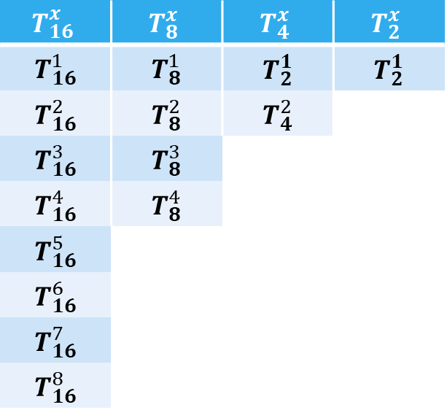
Fast Fourier Transform (FFT) Setup
Background
Demo
The Surface Simulation
The Appearance of Water
Additional Effects
Project Breakdown
The Twiddle Factor
$$T_{16}^{x}$$ | $$T_{8}^{x}$$ | $$T_{4}^{x}$$ | $$T_{2}^{x}$$
$$T_{16}^{1}$$ | $$T_{8}^{1}$$ | $$T_{2}^{1}$$ | $$T_{2}^{1}$$
$$T_{16}^{2}$$ | $$T_{8}^{2}$$ | $$T_{4}^{2}$$
$$T_{16}^{3}$$ | $$T_{8}^{3}$$
$$T_{16}^{4}$$ | $$T_{8}^{4}$$
$$T_{16}^{5}$$
$$T_{16}^{6}$$
$$T_{16}^{7}$$
$$T_{16}^{8}$$
$$T_{N}^{x}=e^{\frac{i2πx}{N}}$$
Table 1: Twiddle factors for a data set of size 16

Slide 25
Fast Fourier Transform (FFT)
Background
Demo
The Surface Simulation
The Appearance of Water
Additional Effects
Project Breakdown
Bit Reversed Index Order
0 | 1 | 2 | 3 | 4 | 5 | 6 | 7 | 8 | 9 | 10 | 11 | 12 | 13 | 14 | 15
0 | 2 | 4 | 6 | 8 | 10 | 12 | 14 | 1 | 3 | 5 | 7 | 9 | 11 | 13 | 15
0 | 4 | 8 | 12 | 2 | 6 | 10 | 14 | 1 | 5 | 9 | 13 | 3 | 7 | 11 | 15
0 | 8 | 4 | 12 | 2 | 10 | 6 | 14 | 1 | 9 | 5 | 13 | 3 | 11 | 7 | 15
Table 2: Bit reversed index order for a data set of size 16

Slide 26
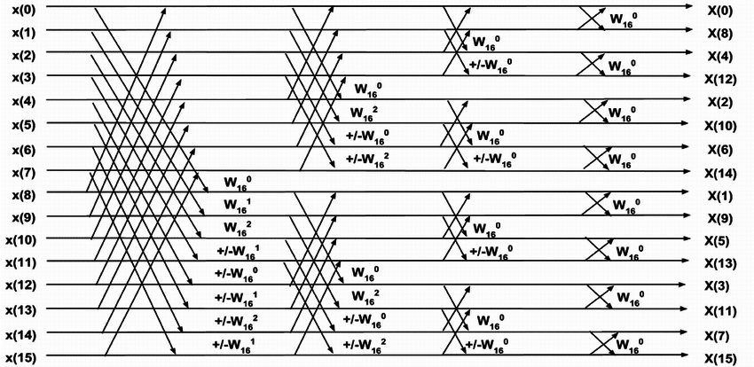


Calculating FFT
Background
Demo
The Surface Simulation
The Appearance of Water
Additional Effects
Project Breakdown
0 | 8 | 4 | 12 | 2 | 10 | 6 | 14 | 1 | 9 | 5 | 13 | 3 | 11 | 7 | 15
0 | 4 | 8 | 12 | 2 | 6 | 10 | 14 | 1 | 5 | 9 | 13 | 3 | 7 | 11 | 15
0 | 2 | 4 | 6 | 8 | 10 | 12 | 14 | 1 | 3 | 5 | 7 | 9 | 11 | 13 | 15
0 | 1 | 2 | 3 | 4 | 5 | 6 | 7 | 8 | 9 | 10 | 11 | 12 | 13 | 14 | 15
$$x\left(0\right)=x\left(0\right)+x\left(8\right)∗T_{16}^{1}$$
$$x\left(1\right)=x\left(1\right)+x\left(9\right)∗T_{16}^{2}$$
$$x\left(8\right)=x\left(0\right)−x\left(8\right)∗T_{16}^{1}$$
$$x\left(9\right)=x\left(1\right)−x\left(9\right)∗T_{16}^{2}$$
…
Table 3: Butterfly Algorithm Pairs
$$x\left(0\right)=x\left(0\right)+x\left(4\right)∗T_{8}^{1}$$
$$x\left(1\right)=x\left(1\right)+x\left(5\right)∗T_{8}^{2}$$
$$x\left(4\right)=x\left(0\right)−x\left(4\right)∗T_{8}^{1}$$
$$x\left(5\right)=x\left(1\right)−x\left(5\right)∗T_{8}^{2}$$
$$x\left(8\right)=x\left(8\right)+x\left(12\right)∗T_{8}^{1}$$
$$x\left(9\right)=x\left(9\right)+x\left(13\right)∗T_{8}^{2}$$
$$x\left(12\right)=x\left(8\right)−x\left(12\right)∗T_{8}^{1}$$
$$x\left(13\right)=x\left(9\right)−x\left(13\right)∗T_{8}^{2}$$
…
Figure 6: Butterfly Algorithm [5]

Slide 27
Agenda
Background
Demo
The Surface Simulation
The Appearance of Water
Additional Effects
Project Breakdown

Slide 28
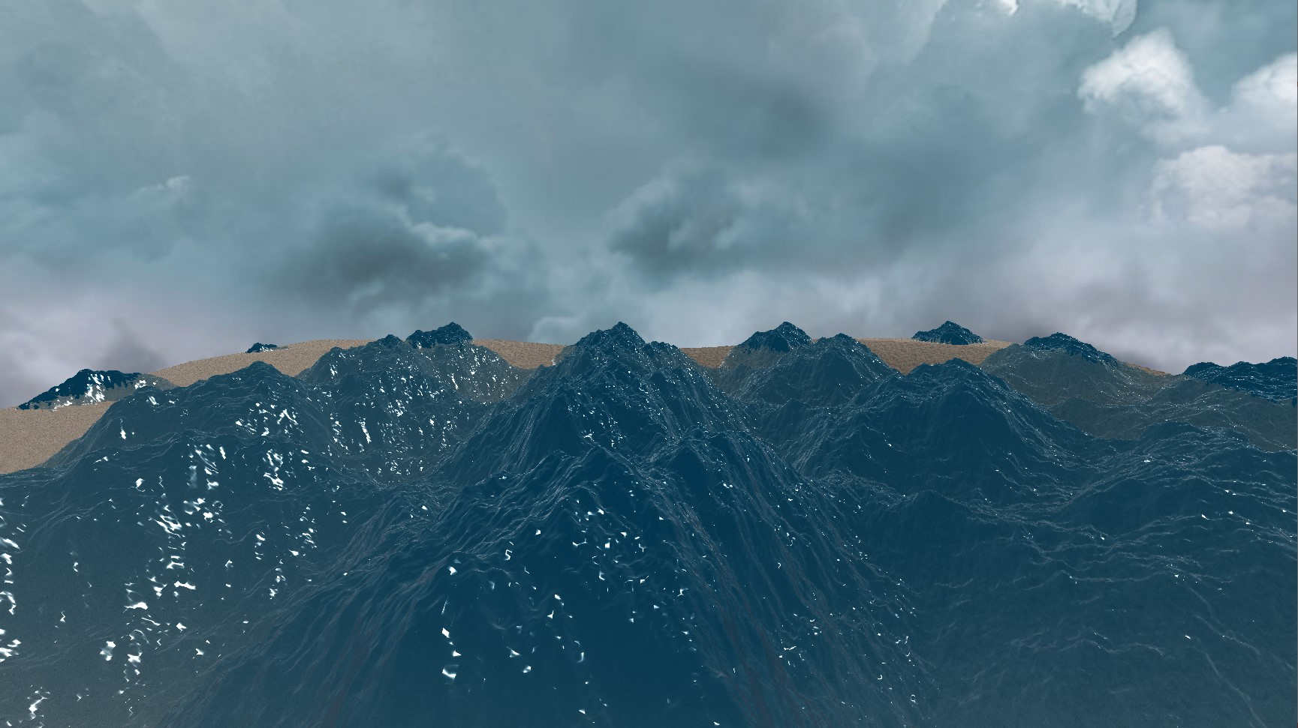
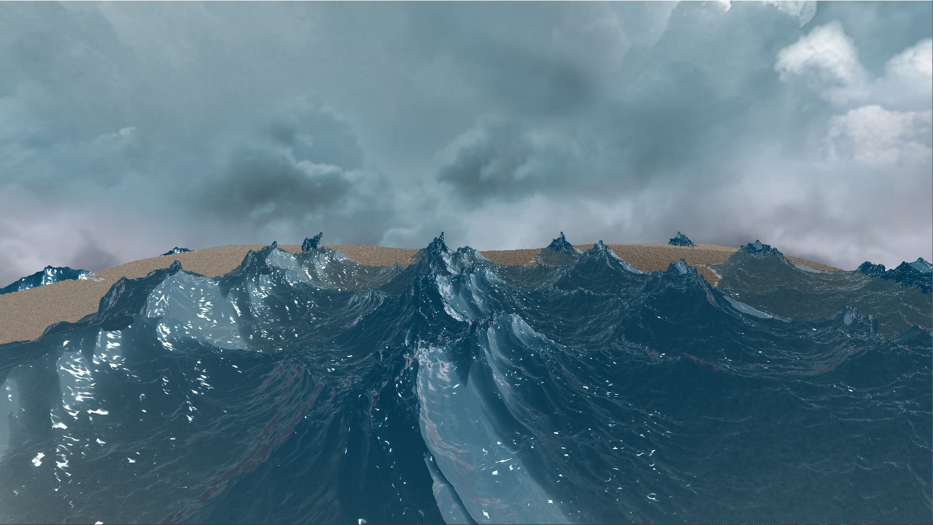
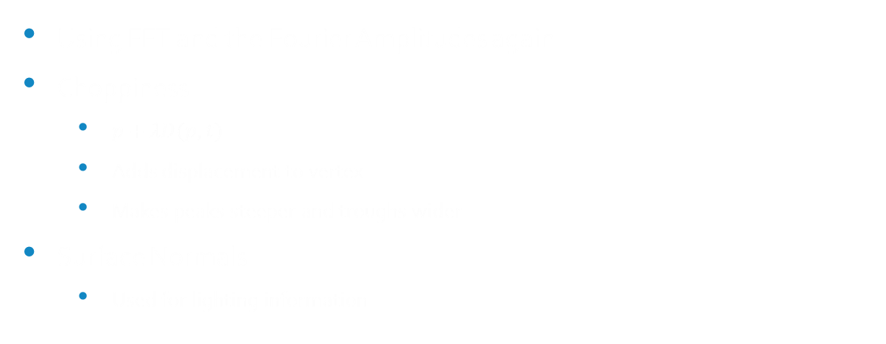


Choppiness and Surface Normals
Background
Demo
The Surface Simulation
The Appearance of Water
Additional Effects
Project Breakdown
Using FFT and the Fourier Amplitudes again
Choppiness
$p+λD(p,t)$
Adds displacement to vertex
Makes peaks steeper and troughs wider
Surface Normals
Used for lighting information
$$D\left(p,t\right)=\sum_{\overset{⃑}{k}}{−i\frac{\overset{⃑}{k}}{\left\|k\right\|}\tilde{h}(\overset{⃑}{k},t)}e^{i\overset{⃑}{k}∙p}$$
Figure 7: Non-choppy water (λ = 0)
$$N\left(p,t\right)=\sum_{\overset{⃑}{k}}{i\overset{⃑}{k}∗\tilde{h}(\overset{⃑}{k},t)}e^{i\overset{⃑}{k}∙p}$$
Figure 8: Choppy water ( λ = -1)

Slide 29
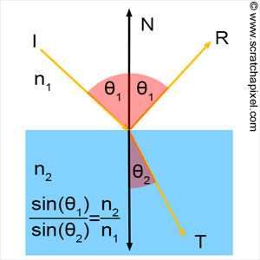
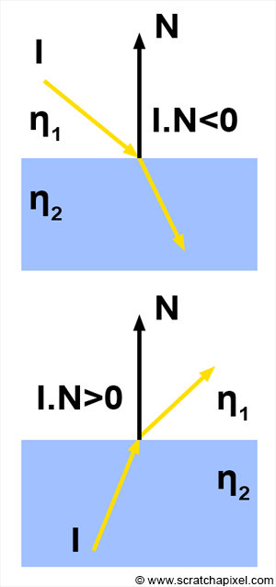
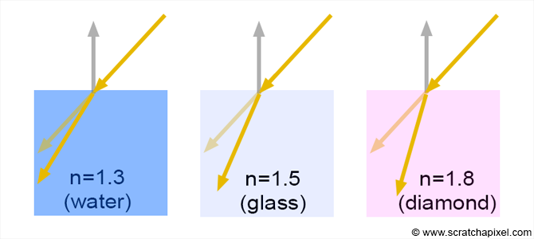

Refraction and Snell’s Law
Background
Demo
The Surface Simulation
The Appearance of Water
Additional Effects
Project Breakdown
Snell’s Law
$$n_{i}\sin{θ_{i} }=n_{t}\sin{θ_{t}}$$
$n_{i}$ = Incident Refractive Index
$n_{t}$ = Transmission Refractive Index
$θ_{i}$ = Angle of Incidence
$θ_{t}$ = Refracted Angle
Figure 9: Reflection and Transmission [6]
Figure 11: Reversed Reflection and Transmission [6]
Figure 10: Effects of Different Refractive Index Values [6]

Slide 30
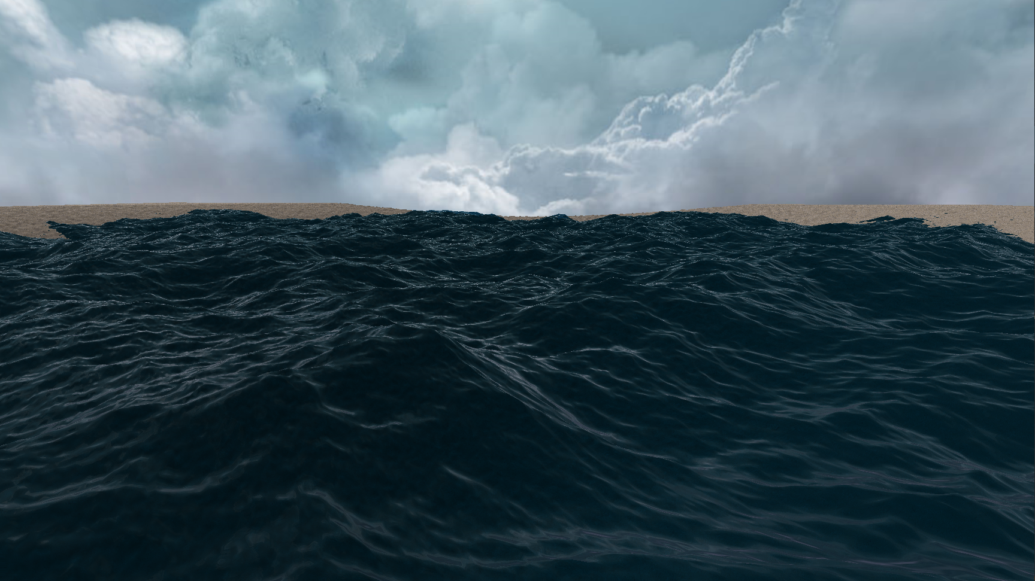
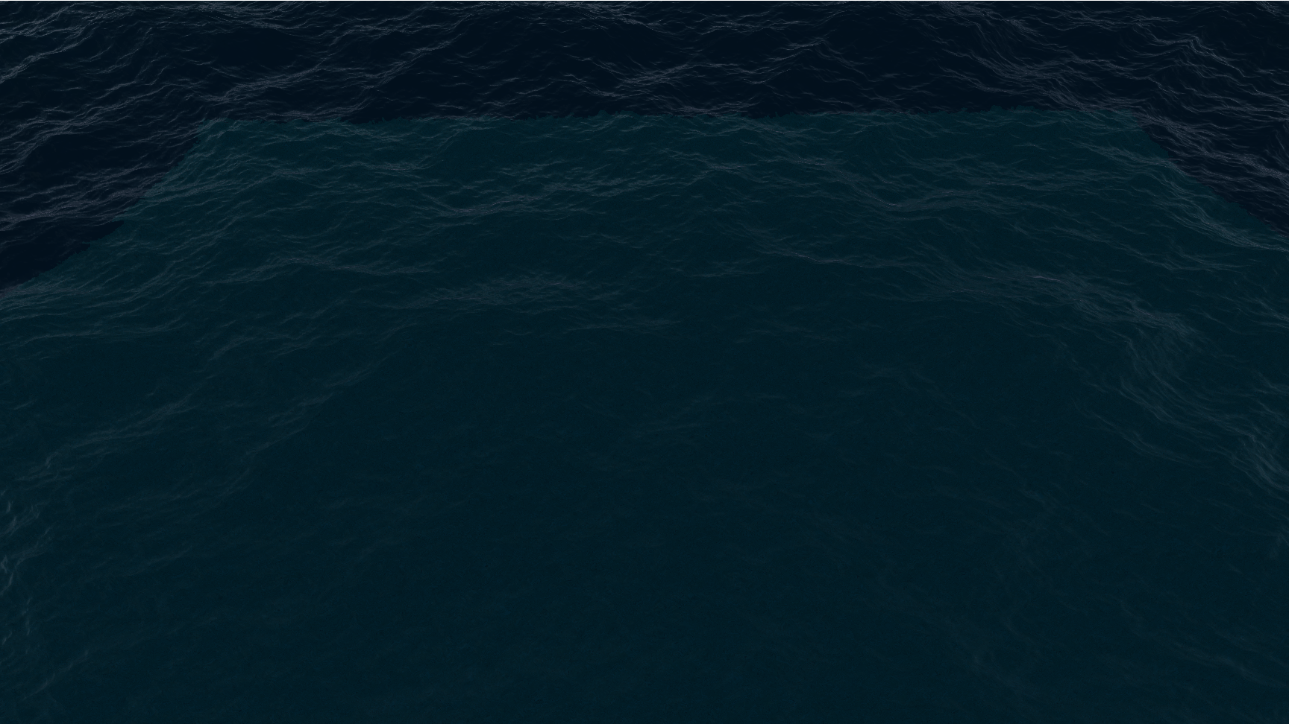



Fresnel
Background
Demo
The Surface Simulation
The Appearance of Water
Additional Effects
Project Breakdown
Fresnel Reflectivity and Transmissivity
$$R + T = 1$$
$$Reflectance=\frac{1}{2}\left\{\frac{\sin^{2}(θ_{t}−θ_{i})}{\sin^{2}(θ_{t}+θ_{i})}+\frac{\tan^{2}(θ_{t}−θ_{i})}{\tan^{2}(θ_{t}+θ_{i})}\right\}$$
Figure 12: Effects of Fresnel at an Indirect Angle
$$Reflected Color = R ∗ Reflection Sample$$
$$Transmitted Color = T ∗ Floor Sample$$
$$Water Surface Color =$$
$$Reflected Color + Transmitted Color + Specular Highlight$$
Figure 13: Effects of Fresnel at a Direct Angle

Slide 31
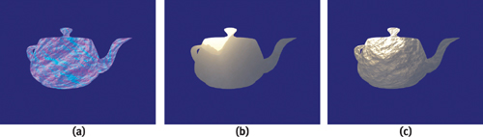
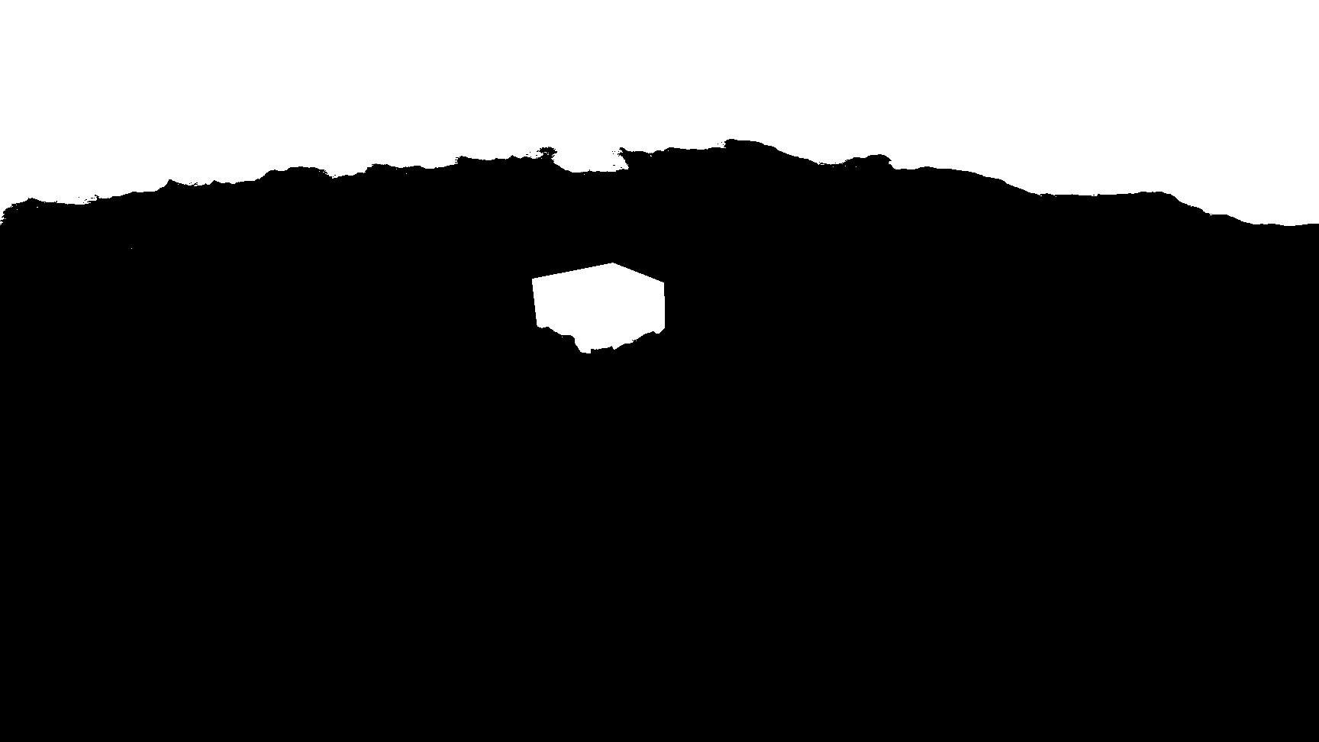
Perturbations
Background
Demo
The Surface Simulation
The Appearance of Water
Additional Effects
Project Breakdown
Offset based on normal
Normals changing from simulation
Refraction Map generation
Although inaccurate, decent results
Easily avoids the problem of sampling outside the backbuffer
Figure 14: Perturbation Texture Sampling [7]
Figure 15: Refraction mapping

Slide 32
Agenda
Background
Demo
The Surface Simulation
The Appearance of Water
Additional Effects
Project Breakdown

Slide 33
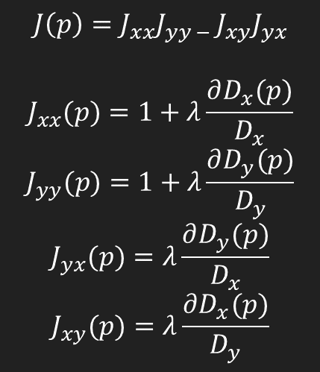
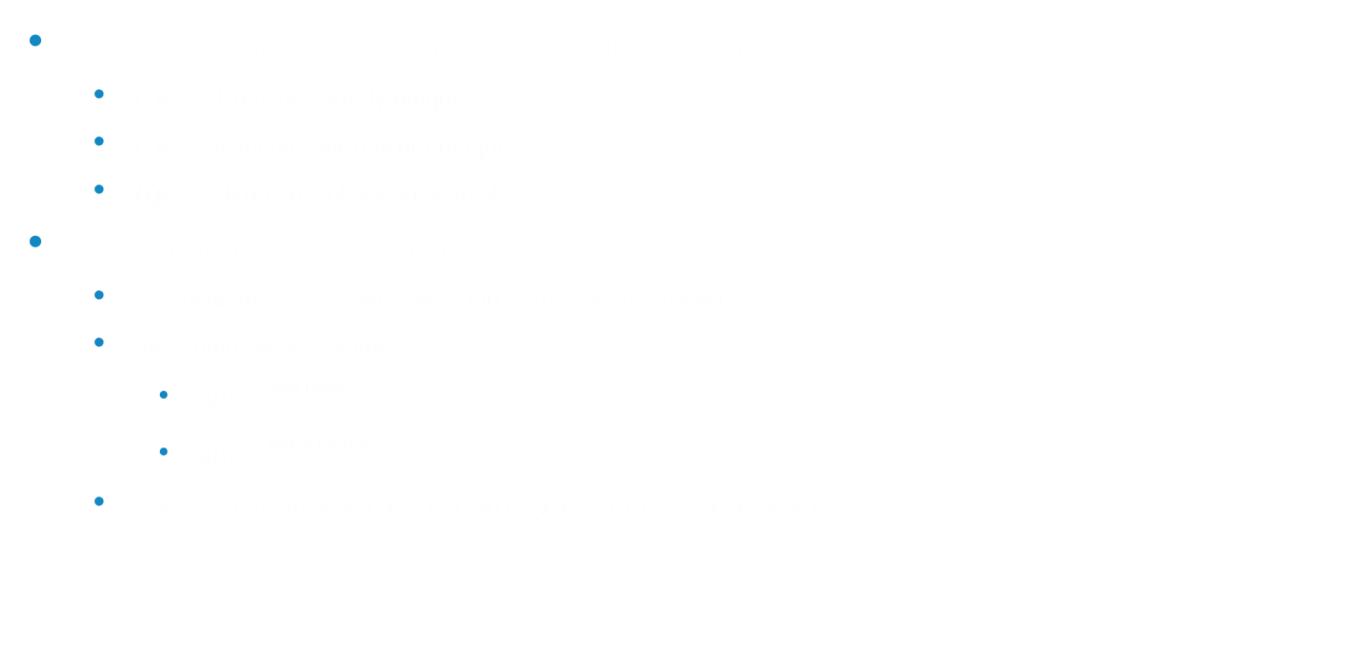
Jacobian
Background
Demo
The Surface Simulation
The Appearance of Water
Additional Effects
Project Breakdown
$$J\left(p\right)=J_{xx}J_{yy − }J_{xy}J_{yx}$$
$$J_{xx}(p)=1+λ\frac{∂D_{x}(p)}{D_{x}}$$
$$J_{yy}(p)=1+λ\frac{∂D_{y}(p)}{D_{y}}$$
$$J_{yx}(p)=λ\frac{∂D_{y}(p)}{D_{x}}$$
$$J_{xy}(p)=λ\frac{∂D_{x}(p)}{D_{y}}$$
Measure of uniqueness of the horizontal displacement
$J\left(p\right)=1$ means entirely unique
$J\left(p\right)=0$ means entirely not unique
$J(p) < 0$means folding in on itself
Approximating the Jacobian Matrix value
Sampling in each cardinal direction of the specified point
Averaging displacements
$dDx=\frac{east+west}{2}$
$dDy=\frac{north+south}{2}$
$J\left(x\right)=( 1 + dDx.x ) ∗ ( 1 + dDy.y ) − ( dDx.y ∗ dDy.x )$
Figure 16: Jacobian Implementation

Slide 34
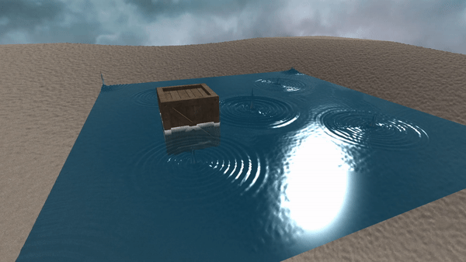
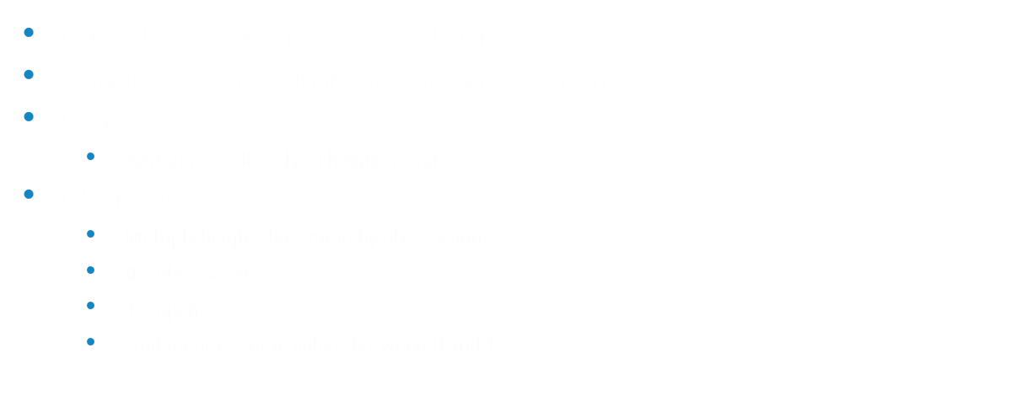
iWave
Background
Demo
The Surface Simulation
The Appearance of Water
Additional Effects
Project Breakdown
Can be layered on top of FFT simulation
Convolutes heights within a moving window on grid
Sources
Add sources directly to height at frame
Obstructions
Multiply height that frame by obstruction
$0$ = obstructed
$1$ = open
Grid requires some values between $0$ and $1$
Figure 17: iWave causing ripples

Slide 35
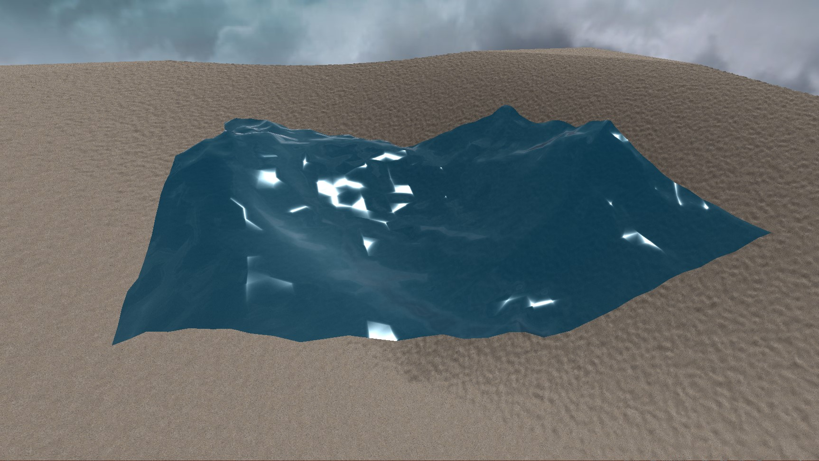
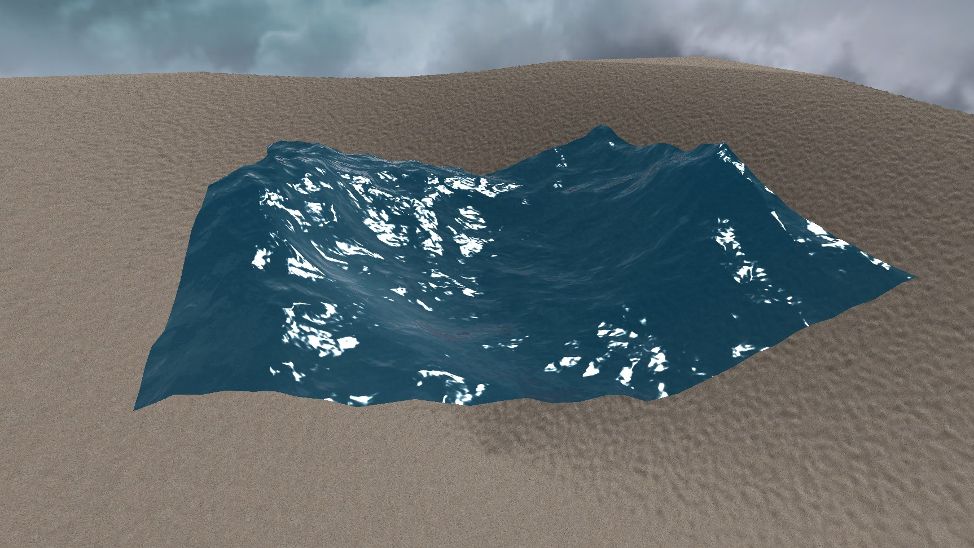
Scrolling Normals
Background
Demo
The Surface Simulation
The Appearance of Water
Additional Effects
Project Breakdown
Using a normal texture to gain higher wave detail
Simple and easy to get working
Can save on performance
Figure 18: Low-poly mesh without scrolling normals
Figure 19: Low-poly mesh with scrolling normals

Slide 36
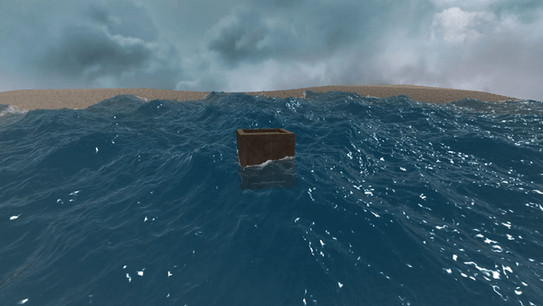
Floating Objects
Background
Demo
The Surface Simulation
The Appearance of Water
Additional Effects
Project Breakdown
Average height of all contained vertices
Average normal of all contained vertices
Create a world transform to modify crates local transform
Figure 20: Simulated floating object

Slide 37
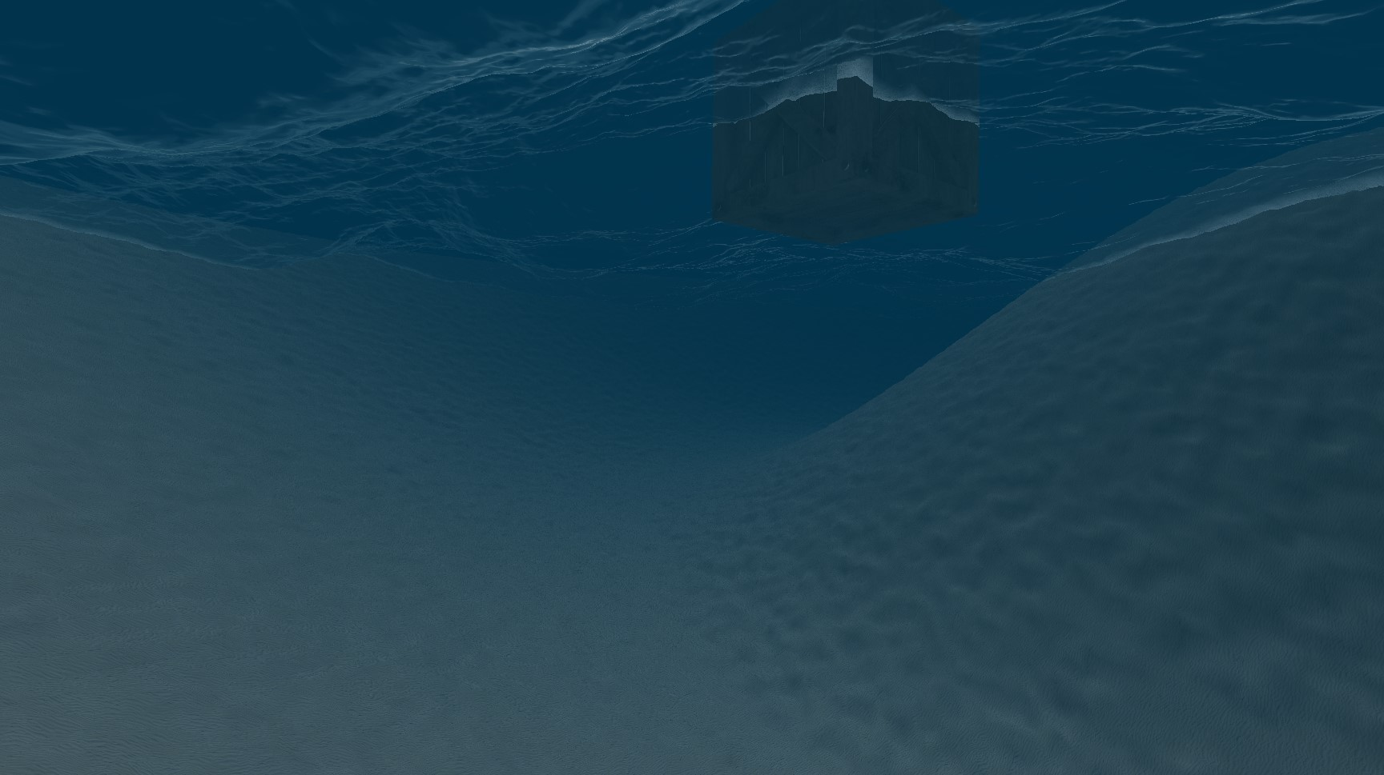
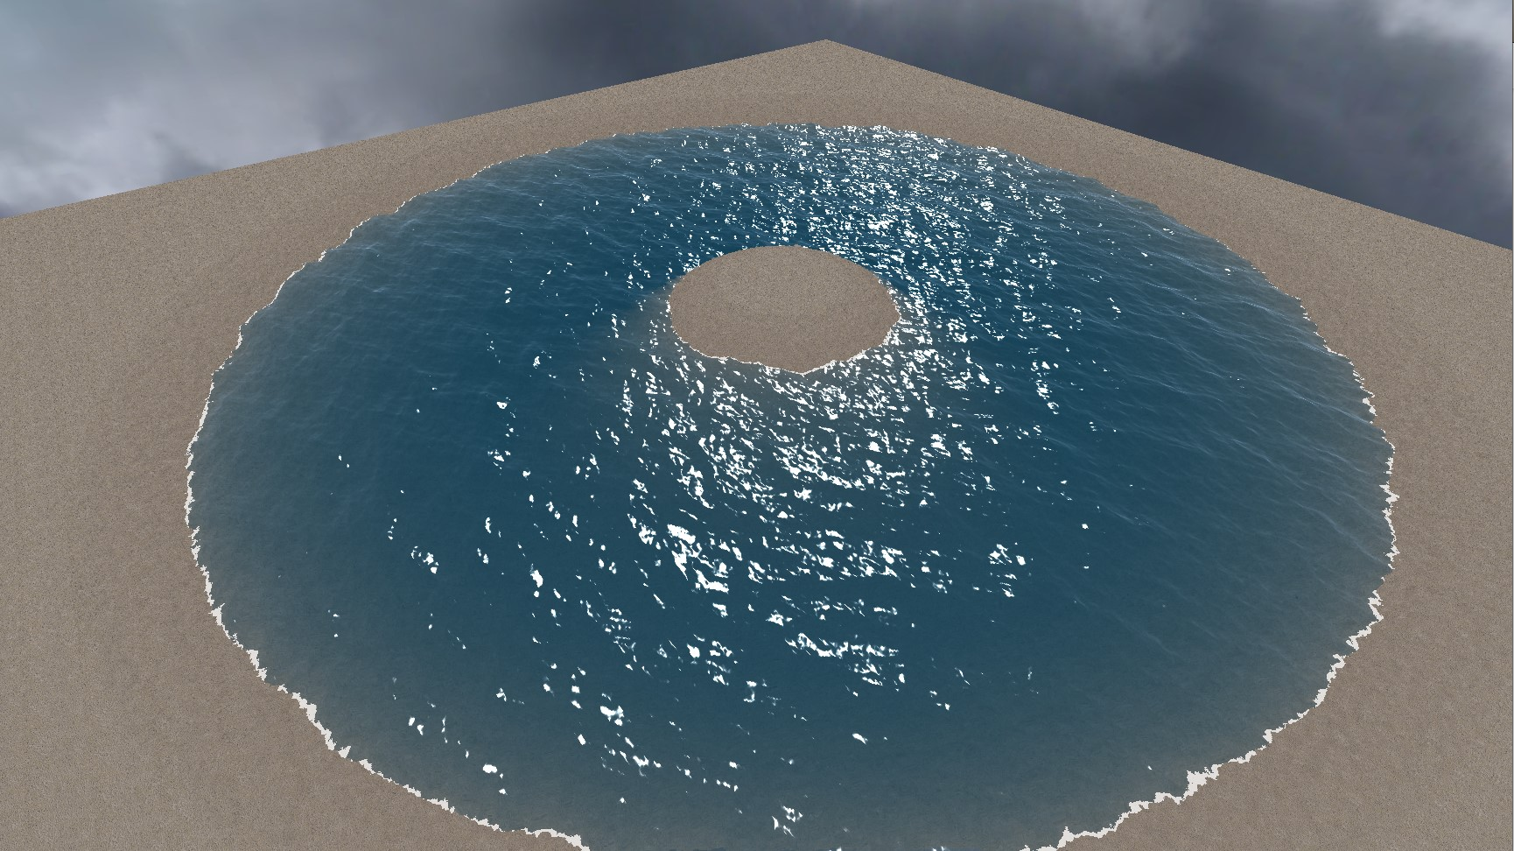
Terrain and Depth
Background
Demo
The Surface Simulation
The Appearance of Water
Additional Effects
Project Breakdown
Terrain
Max Depth
Foam
Figure 21: Underwater effect achieve by fading to max depth
Figure 22: Creating foam and shallow depths

Slide 38
Agenda
Background
Demo
The Surface Simulation
The Appearance of Water
Additional Effects
Project Breakdown

Slide 39
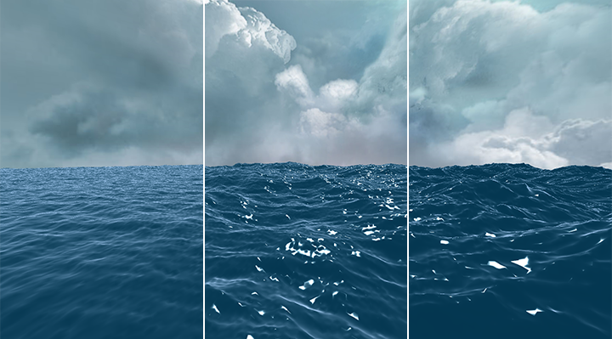
How Does It Fit?
Background
Demo
The Surface Simulation
The Appearance of Water
Additional Effects
Project Breakdown
Complex set of equations
Computationally heavy
A large portion of the game needs to revolve around the water
High level of wave detail
Easy value manipulation
Figure 23: Still, Calm, and Choppy water
(left to right)

Slide 40
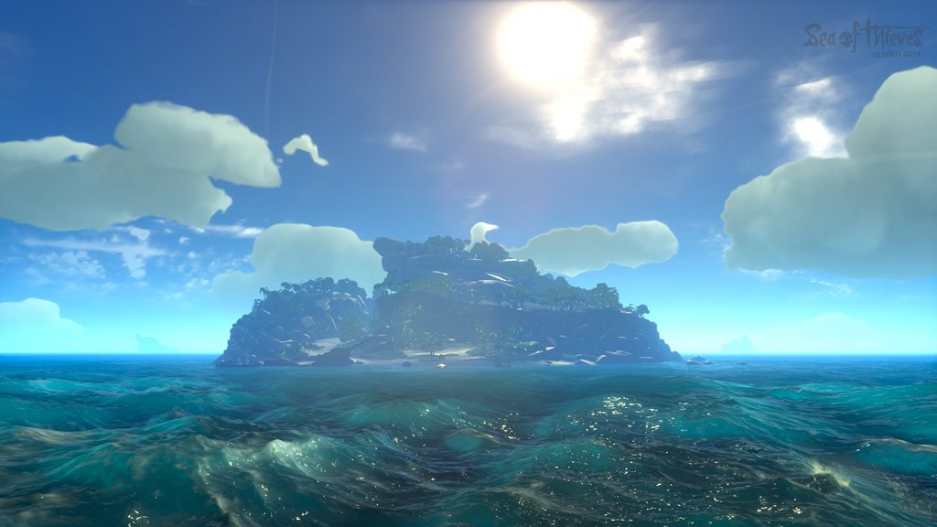
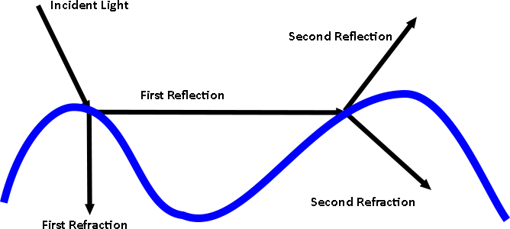
Where to Go From Here
Background
Demo
The Surface Simulation
The Appearance of Water
Additional Effects
Project Breakdown
Improve performance
Calculate on the GPU
Mesh density based on distance from camera
Further investigate iWave implementations
Overall improvement on aesthetics
Jacobian matrix
Raytracing
Figure 23: Sea of Thieves Jacobian Effect [8]
Figure 24: Complexity of light’s interaction with water [4]

Slide 41
References
[1] | K. Stuart, "Sea of Thieves: How Rare Silenced the Cannons and Brought Peace to the Seas," 18 July 2018. [Online]. Available: https://www.theguardian.com/games/2018/jul/18/sea-of-thieves-rare-games-update-the-hungering-deep-cursed-sails-forsaken-shores. [Accessed 19 July 2020].
[2] | M. Ruiz, "Sea of Thieves Review — A Whole Lot of Booty," 29 March 2018. [Online]. Available: https://www.dualshockers.com/sea-of-thieves-review-xbox-one/. [Accessed 19 July 2020].
[3] | M. Martin, "Sea of Thieves Reviews Round-up – All the Scores for Rare’s Wonky Pirate Adventure," 22 March 2018. [Online]. Available: https://www.vg247.com/2018/03/22/sea-of-thieves-reviews-scores/. [Accessed 19 July 2020].
[4] | J. Tessendorf, "Simulating Ocean Water," 2004. [Online]. Available: https://people.cs.clemson.edu/~jtessen/reports/papers_files/coursenotes2004.pdf.
[5] | J. Suto, "ReasearchGate," [Online]. Available: https://www.researchgate.net/figure/The-butterfly-structure-of-the-modified-algorithm-On-the-figure-indicates-the_fig2_281029093. [Accessed 5 May 2021].
[6] | Scratchapixel, "Reflection, Refraction (Transmission) and Fresnel," scratchapixel, [Online]. Available: https://www.scratchapixel.com/lessons/3d-basic-rendering/introduction-to-shading/reflection-refraction-fresnel. [Accessed 5 May 2021].
[7] | J. Suto, "ReasearchGate," [Online]. Available: https://www.researchgate.net/figure/The-butterfly-structure-of-the-modified-algorithm-On-the-figure-indicates-the_fig2_281029093. [Accessed 5 May 2021].
[8] | "Screen ShARRe - Your Best Sea of Thieves Screenshots!," [Online]. Available: https://images.app.goo.gl/ZweGrdknN7SuxwWq5. [Accessed 5 May 2021].

